Slide 1
VHC
Sprint Demo : 2023 - 03 - 27

Slide 2





Table of Contents
1- SPRINT GOAL
2- STATUS
3- DEMO
4- FEEDBACK

Slide 3
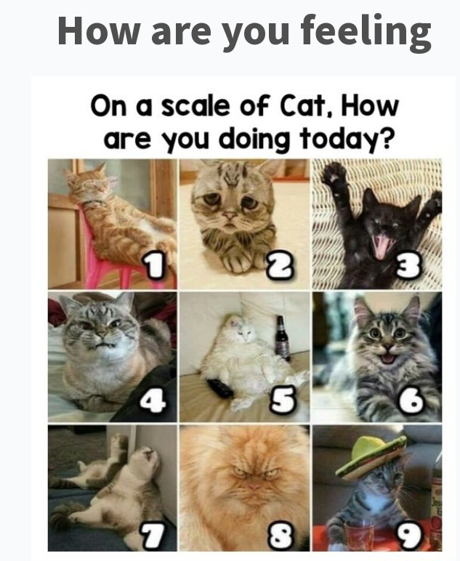

Slide 4
What were the goals this sprint

Slide 5




Design: Complete design Boards.
Design: Finish the developer Console in High Fidelity
BD: Refine the target audience / Strategy
SCRUM: have live sprint demo ready

Slide 6
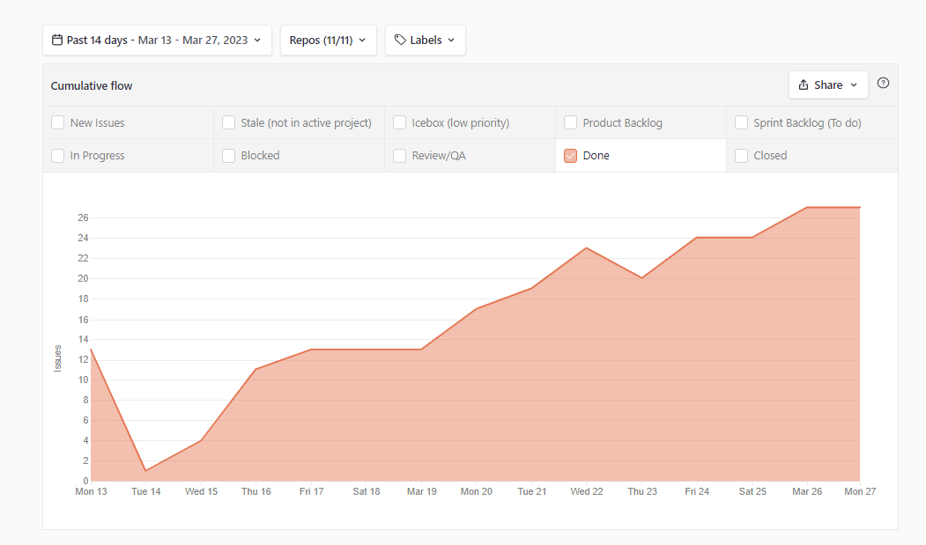
Cumulative Flow Diagram

Slide 7


🏗️DEV
🎨DESIGN
🏉ADMIN/SCRUM
🤝BD
User
Direct value
Enablers
🏗️User is initialized from storage on app start, reconnect to services and invalid users logged out
🏗️PIN challenge screen UI
🏗️Change PIN and Biometrics choice screen UI
🏗️Loading page after click “Login with Tonomy ID”
🏗️Back button logic on home screen
🏗️Teardown florence infrastructure
✔️saves $$/month
🏗️Staging demo prepared
✔️stakeholders see app working
🏉Demo presentation prepared
✔️understand work done
🎨Internal user testing Tonomy Dev Console
✔️Design aligns with users
🎨Demo design includes code preview for devs
✔️Demo site educates devs
🎨Updated Tonomy Dev Console from feedback
✔️upgrades to features/audience
🏉OKR understanding
✔️ready to prepare to align with stakeholders

Slide 8
🏗️DEV
🎨DESIGN
🏉ADMIN/SCRUM
🤝BD
User
Direct value
Enablers
🤝Crm has all contacts migrated
✔️CRM ready for sales
🏗️External API class for integrators setup
✔️external apps ready for integrate with Tonomy ID
🏗️SSO protocol E2E integration test
✔️protects code from error
🏗️Refactoring the login function to check the password more modular
✔️reduces bug frequency

Slide 9
🏗️DEV
🎨DESIGN
🏉ADMIN/SCRUM
🤝BD
User
Direct value
Enablers
🏗️Bug fixes for version bumping
🏗️Bug fix for TID expo deployment
🏗️Bug fix UI overlap in create password
✔️ensure our infrastructure and app are working properly
🏗️get DID of user
✔️clearer for developers work together
🏗️Staging deployment of Demo and SSO login website
✔️staging app is ready for use

Slide 10
🏗️DEV
🎨DESIGN
🏉ADMIN/SCRUM
🤝BD
User
Direct value
Enablers
🏗️Communication service authorization checks
✔️prevents security risk of one user sending message, pretending to be other and spamming recipient

Slide 11

Demo

Slide 12
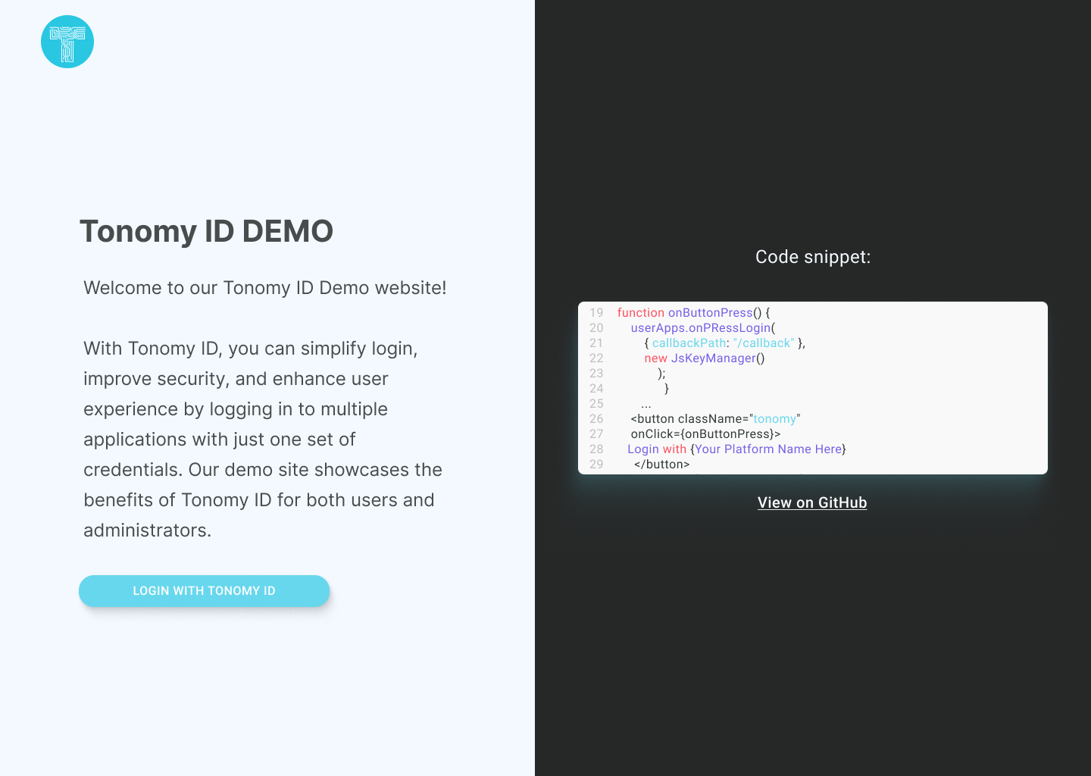
🎨DESIGN
🎨Demo design includes code preview for devs

Slide 13
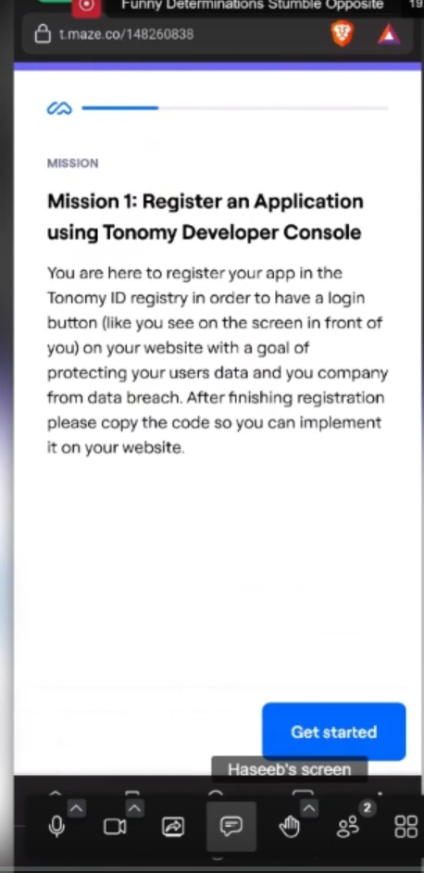
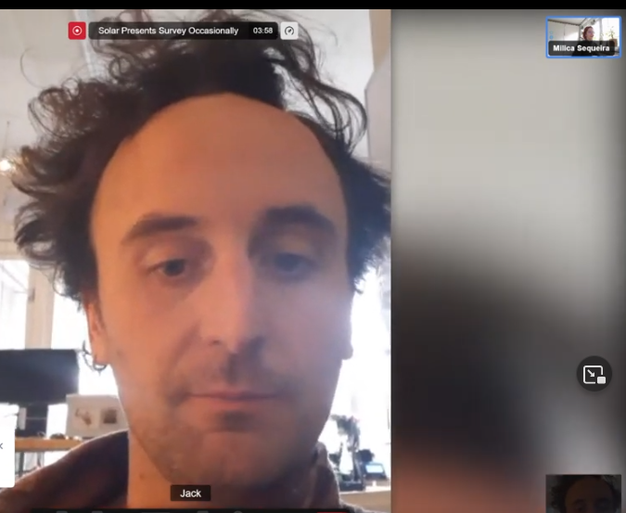
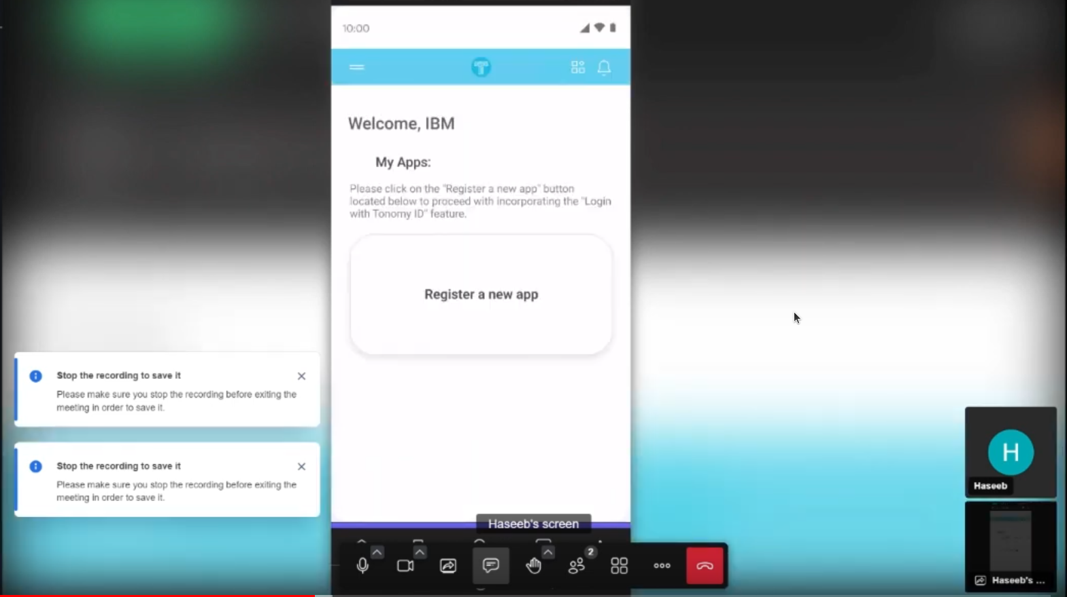
🎨DESIGN
🎨Internal user testing Tonomy Dev Console
See the docs!
https://drive.google.com/drive/u/1/folders/1BgE1yS9rg4-uGDHntvxnyBNFhLwgH50g

Slide 14
🏗️DEV
🏗️User is initialized from storage on app start and invalid users logged out
If the user logs into another device the user should be logged out of their current device;
🏗️PIN challenge screen UI
🏗️Change PIN and Biometrics choice screen UI
The Tonomy ID app now has change PIN and biometric and PIN challenge screens visually implemented (but no logic)
🏗️Back button logic on home screen
If the user presses the OS back button on the home screen, they should exit the app.

Slide 15
🏗️DEV
🏗️Loading page after click “Login with Tonomy ID” UI
🏗️SSO website shows app information UI
A loading page is shown while the app decides what to do with the user (instead of blank screen)
Then it shows the app information page (on desktop login) while waiting for phone to accept request

Slide 16
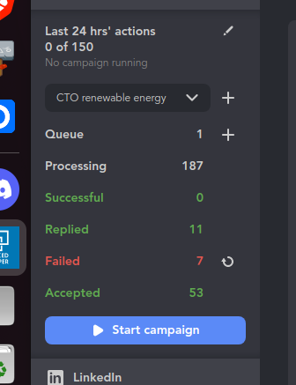
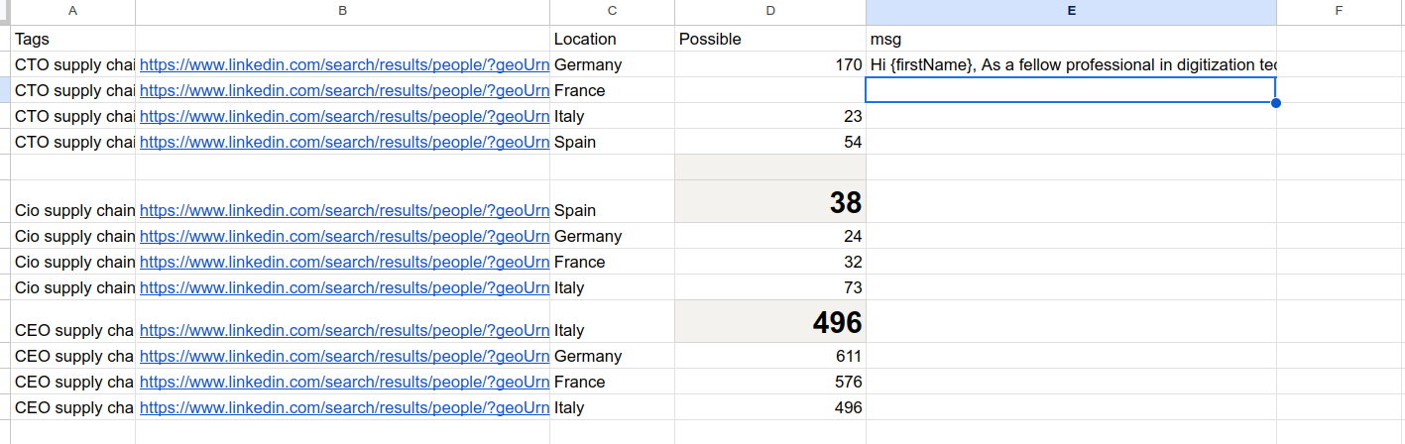
🤝BD

Slide 17
Feedback ?

